Slide 1


CAPSTONE PROJECT AI-POWERED IDS SYSTEM
Presented By
Student Name: VARSHINI G S
College Name: AMRITA VISHWA VIDYAPEETHAM
Department: ELECTRICAL AND ELECTRONICS ENGINEERING
Email ID: varshiniganesh999@gmail.com
AICTEStudent ID:STU6767e24bbd2d21734861387

Slide 2
OUTLINE
Problem Statement
Proposed System/Solution
System Development Approach
Algorithm & Deployment
Result
Conclusion
Future Scope
References

Slide 3
Problem Statement
In today’s digitally connected world, cyber-attacks are becoming increasingly sophisticated and frequent. Traditional signature-based Intrusion Detection Systems (IDS) struggle to identify new or evolving threats. Organizations face challenges in proactively detecting anomalies in real-time due to high false alarm rates and limitations in manual rule configuration. There is a critical need for intelligent, adaptive systems that can detect intrusions with high accuracy and minimal human intervention.

Slide 4
Proposed Solution
The proposed system leverages artificial intelligence to automatically detect and classify network intrusions by analyzing traffic patterns. The solution pipeline includes:
Data Collection: Uses benchmark dataset CICIDS2017, which include a variety of labeled attack and normal traffic records.
Data Preprocessing:
Handling missing values
Feature encoding and normalization
Dimensionality reduction and feature selection for optimal performance
Algorithm: Implements supervised learning algorithms such as:
Random Forest
Optuna-based Tuning
Hyper-parameter Tuning These models are trained to distinguish between normal and malicious traffic.
Deployment: In this project, google colab is used to deploy this model.
Evaluation:
Performance is measured using accuracy, precision, recall, and F1-score.
Visualized using confusion matrix, ROC curves, and correlation matrix.
Models achieve up to 99% accuracy on benchmark datasets.

Slide 5
System Approach
Content:
Programming Language: Python
Libraries & Tools:
Scikit-learn – ML algorithm implementation
Keras/TensorFlow – Deep learning model development
Pandas, NumPy – Data preprocessing and analysis
Matplotlib/Seaborn – Visualization
Dataset: CICIDS2017
Environment: Google Colab

Slide 6
Algorithm & Deployment
Algorithm Selection:
In this project the algorithms used are Random forest classifier, Hyperparameter tuning, and Optuna based tuning
Data Input:
The data inputs used in this project are id dur proto service state spkts dpkts sbytes dbytes ct_dst_sport_ltm ct_dst_src_ltm is_ftp_login ct_ftp_cmd ct_flw_http_mthd ct_src_ltm ct_srv_dst is_sm_ips_ports attack_cat label
Training Process:
Data is preprocessed and relevant features are selected for training. A Random Forest model is chosen and trained on the prepared data. Hyperparameters are optimized to enhance model accuracy and generalization. The trained model is evaluated on unseen data using key metrics.
Prediction Process:
Input data is processed and fed to each decision tree in the forest, generating individual predictions. The final prediction is determined by combining the individual tree predictions through majority voting.

Slide 7
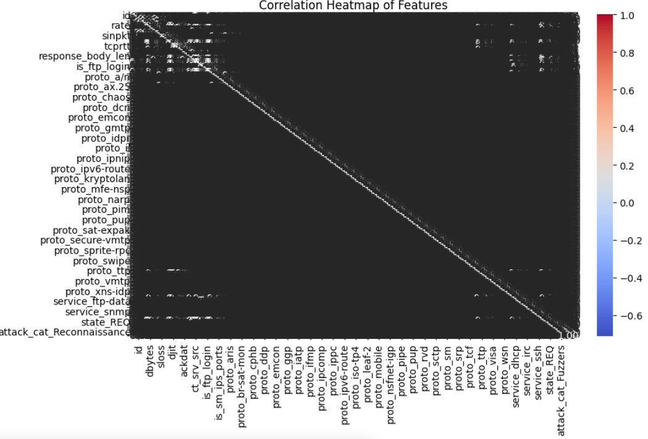
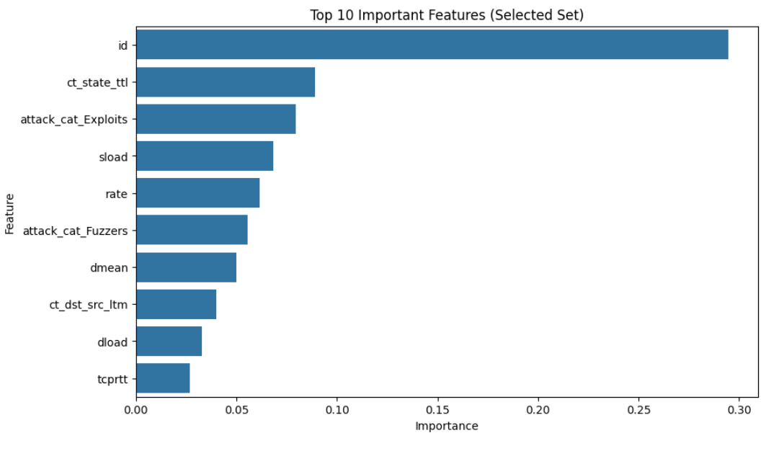
Result
This model achieved the accuracy of 99.7 %, Test accuracy after RandomizedSearchCV is 99.99%, accuracy after selected features is 99.97%

Slide 8
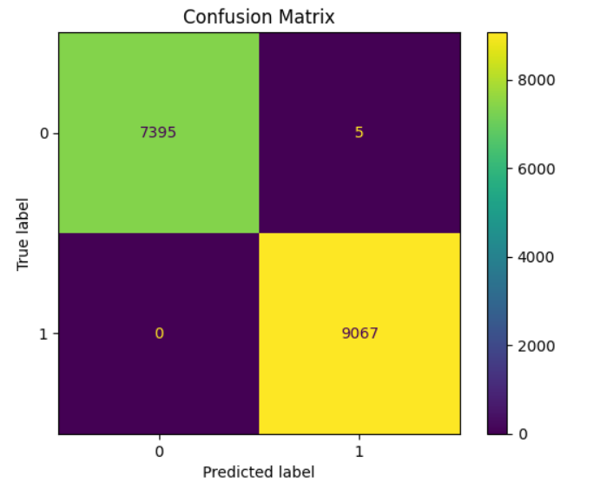
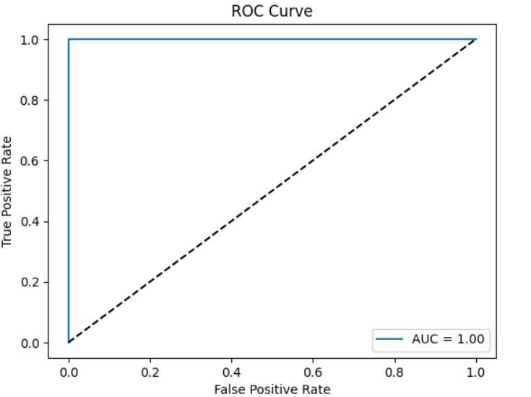

Slide 9
Conclusion
The AI-based Network Intrusion Detection System significantly enhances the ability to detect and respond to network threats. By automating threat detection and learning from data, it reduces the dependency on human-defined rules and adapts to evolving attack vectors, offering robust protection for enterprise networks.

Slide 10
Future scope
Integration with Federated Learning for decentralized threat detection
Real-time deployment on edge devices using TensorFlow Lite
Enhanced attack classification using ensemble models
Blockchain integration for secure logging of attack records
Auto-updating models with online learning techniques

Slide 11
References
Tavallaee, M. et al. (2009). A Detailed Analysis of the KDD CUP 99 Dataset.
CICIDS2017 Dataset.
Scikit-learn Documentation – https://scikit-learn.org
Keras API – https://keras.io
TensorFlow Documentation – https://www.tensorflow.org
GitHub Link: https://github.com/Varshini-svg/AI-Powered-Intrusion-Detection-System-using-Deep-Learning.git

Slide 12
Thank you

